Slide 1
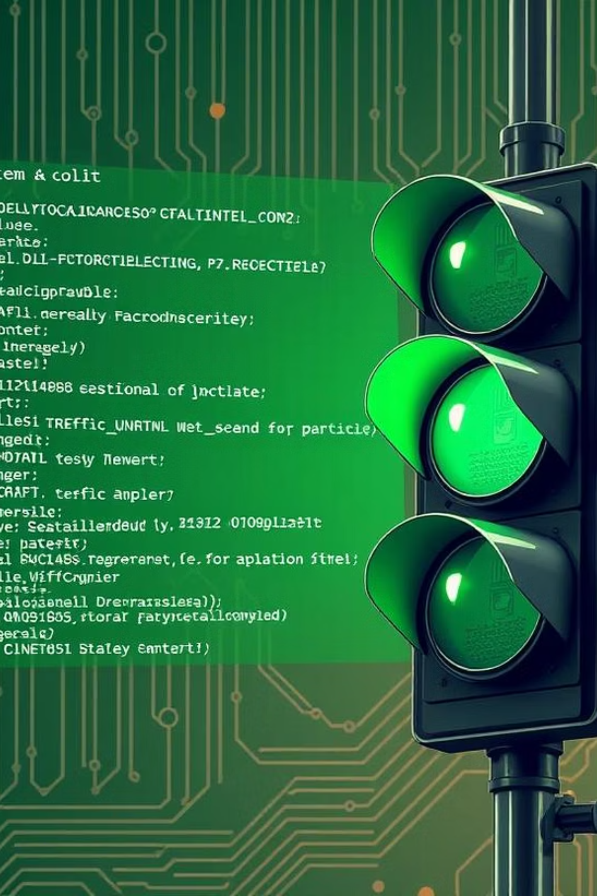
Traffic Light Control System using 8086 Assembly
Presented by: Saved Ali (CU-4181-2023) & Osaid Ahmad (CU-4148-2023)

Slide 2
🔧 Objective
To simulate a traffic light controller using 8086 assembly, activating red, yellow, and green lights in a timed loop via I/O ports and BIOS delays.
📄 Overview of Control Logic
Red lights: Bits 0, 3, 6, 9
Yellow lights: Bits 1, 4, 7, A
Green lights: Bits 2, 5, 8, B
Output is sent to port 4 (assumed connected to traffic lights)

Slide 3
1
2
1. Initialization
2. Initial Delay: 5 Seconds
mov ax, 249h
mov cx, 4Ch
out 4, ax
mov dx, 4B40h
Explanation: All traffic signals are initially red for safety. Value 249h activates red bits only.
mov ah, 86h
int 15h
Explanation: Uses BIOS interrupt INT 15h (Function 86h) to wait for 5 seconds.

Slide 4
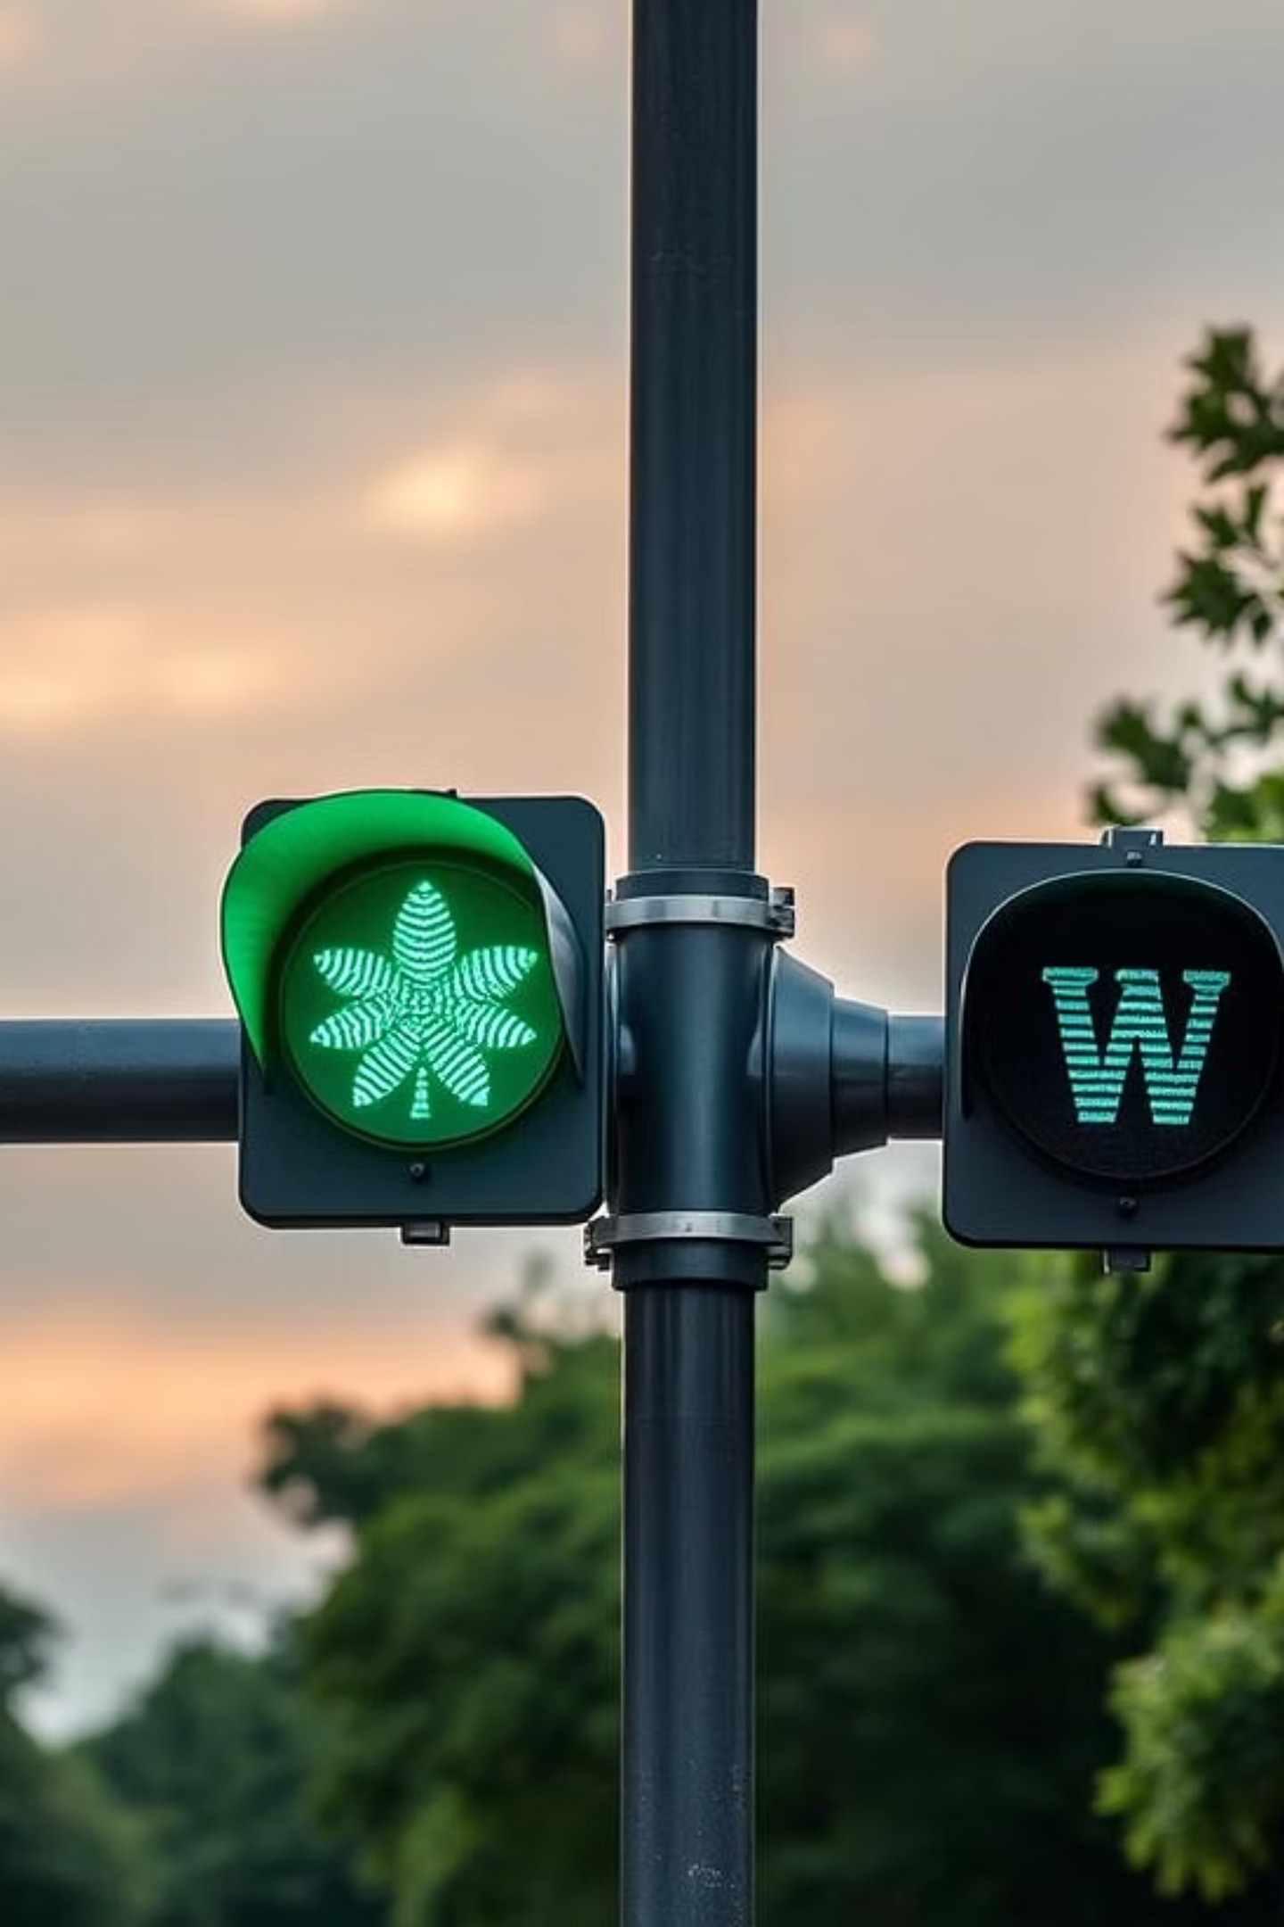
🔁 Start of Loop (lop:)
The main cycle of the traffic light begins here and repeats indefinitely.
3. North & South Green Lights
mov ax, transition1
out 4, ax
Explanation: North & South traffic lights are set to green while East & West remain red.

Slide 5

1
2
4. Wait for 120 Seconds
5. All Yellow Lights
mov cx, 393h
mov ax, transition2
mov dx, 0E040h
out 4, ax
Explanation: Due to BIOS limits, the delay is split into two calls for a total of 120 seconds (2 × 60s).
Explanation: All directions show yellow to alert vehicles of an impending change.

Slide 6
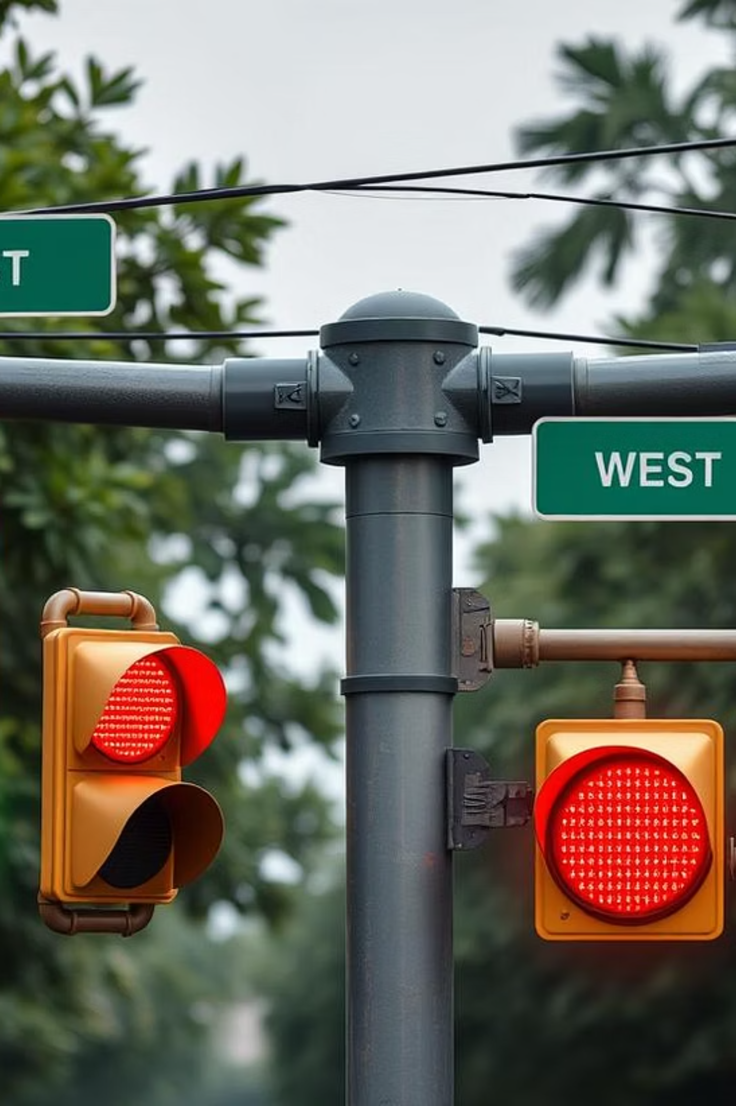
1
6. Wait 60 Seconds
mov cx, 393h
mov dx, 0E040h
Explanation: This delay defines the duration of the all-yellow warning phase.
2
7. East & West Green Lights
mov ax, transition3
out 4, ax
Explanation: Now East & West have the green light, while North & South wait.

Slide 7
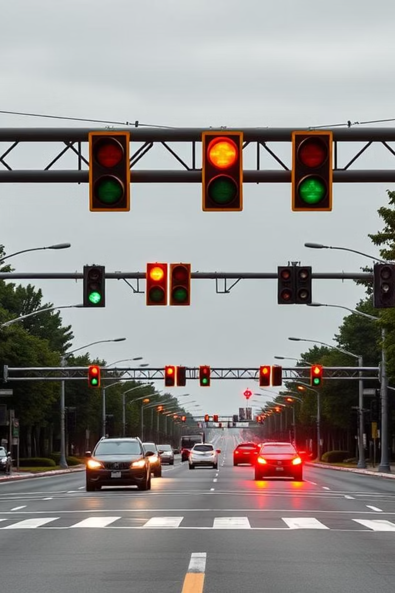
1
8. Wait 120 Seconds Again
Same as before: two calls to BIOS delay for a total of 120 seconds.
2
9. All Yellow Lights Again
mov ax, transition4
out 4, ax
Explanation: Before returning to red, all directions are yellow again, signalling the end of the current cycle.

Slide 8
1
2
10. Wait 60 Seconds Again
🔁 Reset to All Red & Loop
Another delay phase, similar to step 6, before resetting to all red.
mov ax, 249h
out 4, ax
jmp lop
Explanation: The cycle completes, all lights return to red for 5 seconds, and then the main loop restarts indefinitely.

Slide 9
🔢 Bitwise Transition States
State
Binary Pattern
Description
transition1
0000 0011 0000 1100
North & South Green
transition2
0000 0111 1001 1110
All Yellow
transition3
0000 1000 0110 0001
East & West Green
transition4
0000 1100 1111 0011
All Yellow
Each bit pattern corresponds to the active state of traffic lights at different intersections, ensuring proper signal sequencing.

Slide 10



💡 Conclusion
This 8086 assembly program successfully simulates a real-world traffic light system utilising:
I/O Ports
BIOS Interrupts
Bitwise Control
For directing output signals to control light states.
For precise timing and delay management between light changes.
For efficient and granular management of individual light states.

